Slide 1
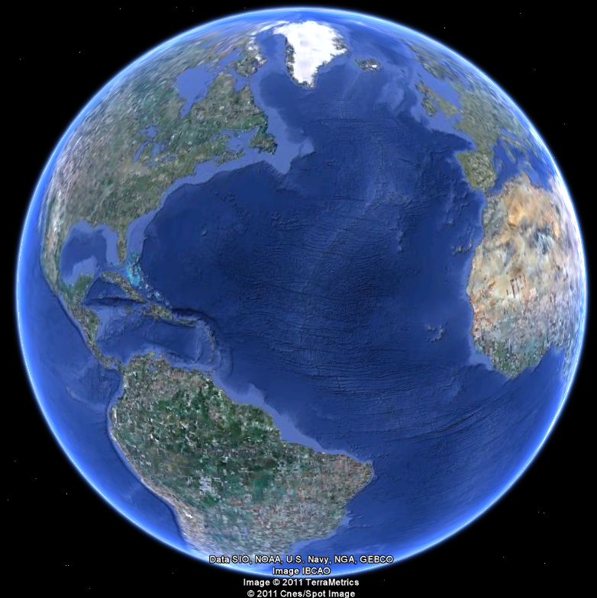
APEC 100 Sustainable Development
Course Introduction

Slide 2

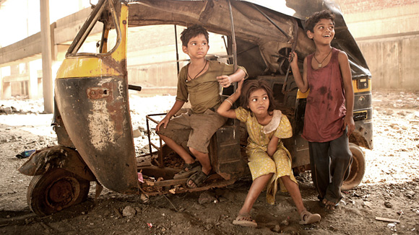
What is Sustainable Development?

Slide 3
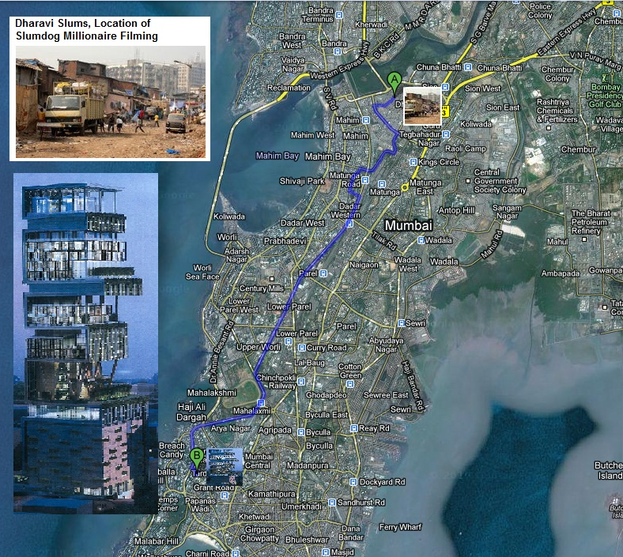
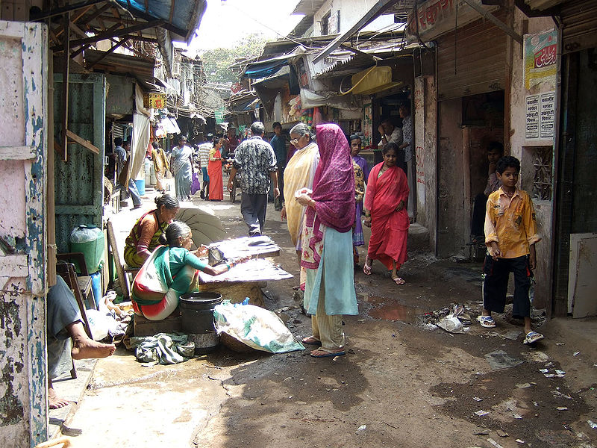
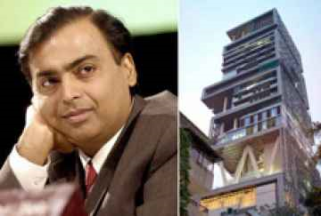
A World of Paradox
Mukesh Ambani’s home
Dharavi, India

Slide 4
~7 miles (19 minute drive)

Slide 5
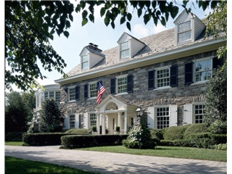
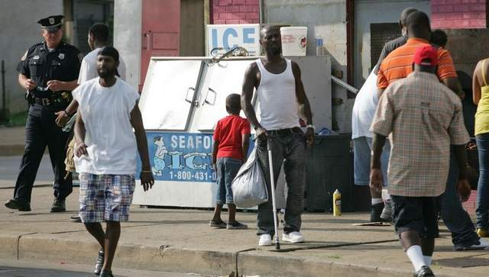
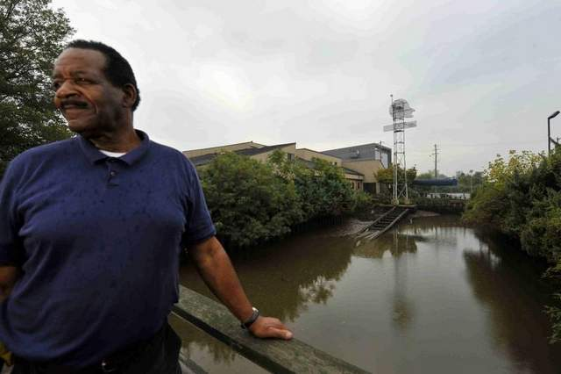
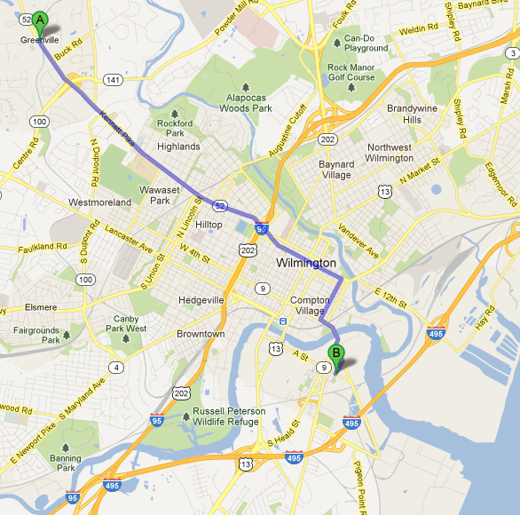
A World of Paradox
Greenville, Delaware
Southbridge, Delaware
5.2 miles apart

Slide 6
Course Description
This course on sustainable development engages students in learning and critical thinking about a variety of pressing issues, such as natural resources, environments, and poverty in an international context, where public policy seeks to improve the well-being of people and the environment.
This course encourages students to think critically about these issues by applying basic policy and economic analysis, considering the ethical dimensions of policy, and assessing indicators of environmental quality and human welfare.
Emerging field of “Sustainability Science”

